Slide 1




Rodrigo Ribeiro Pierini
Data Science and Machine Learning

Slide 2
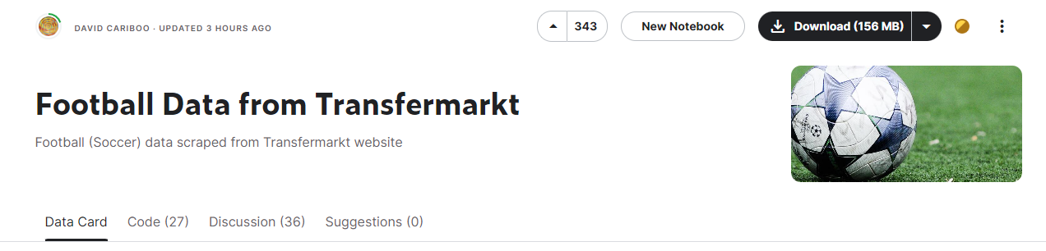
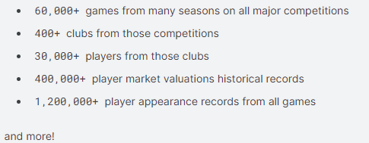
DATASET
https://www.kaggle.com/datasets/davidcariboo/player-scores?select=game_lineups.csv

Slide 3
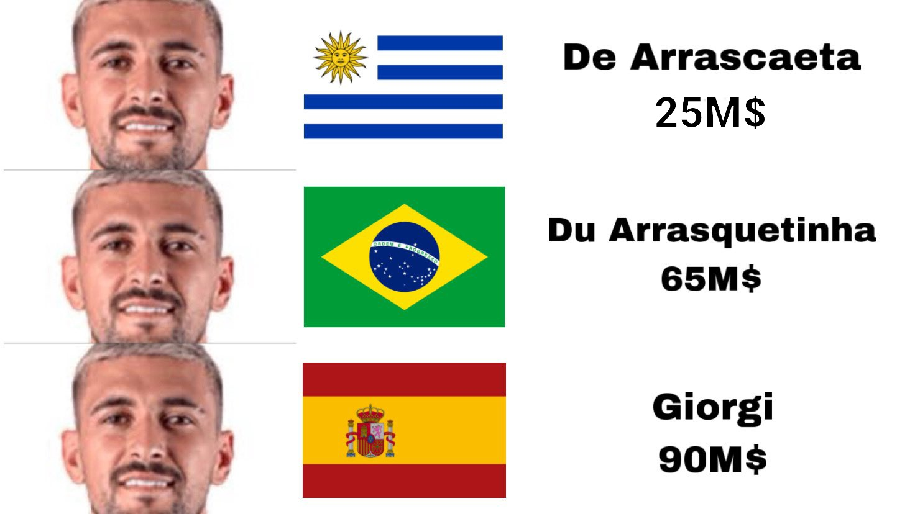
MOTIVATION

Slide 4
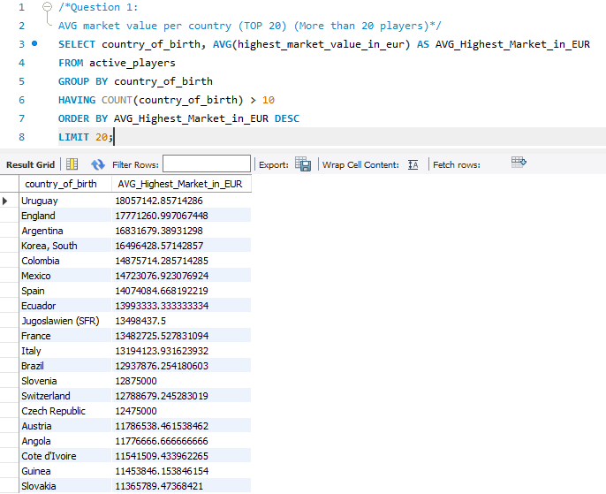
Question 1:
AVG market value per country (TOP 20) (More than 20 players)

Slide 5
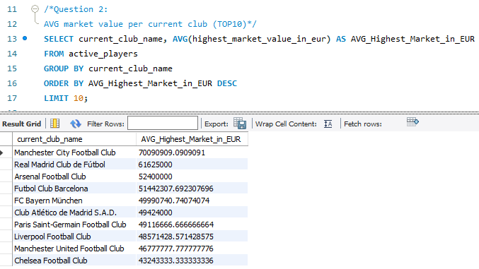
Question 2:
AVG market value per current club (TOP10)

Slide 6
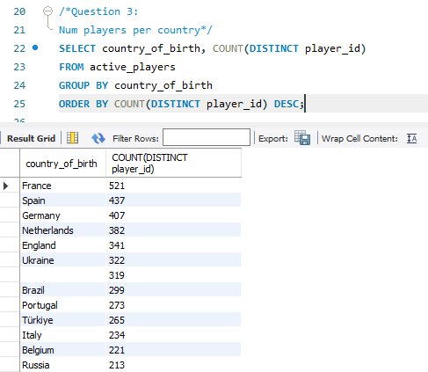
Question 3:
Num players per country

Slide 7
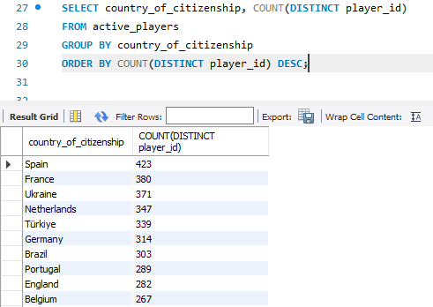
Question 3:
Num players per country (by country of citizenship)

Slide 8
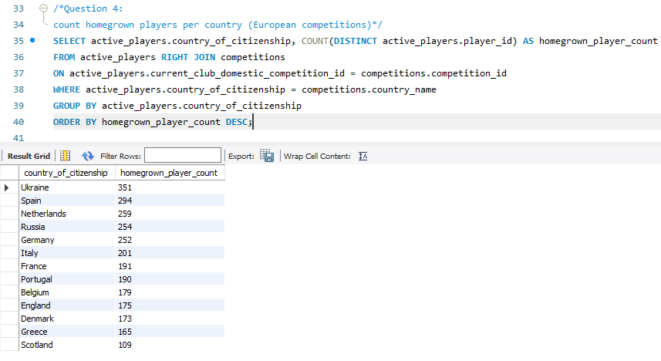
Question 4:
Num homegrown players per country (European competitions)

Slide 9
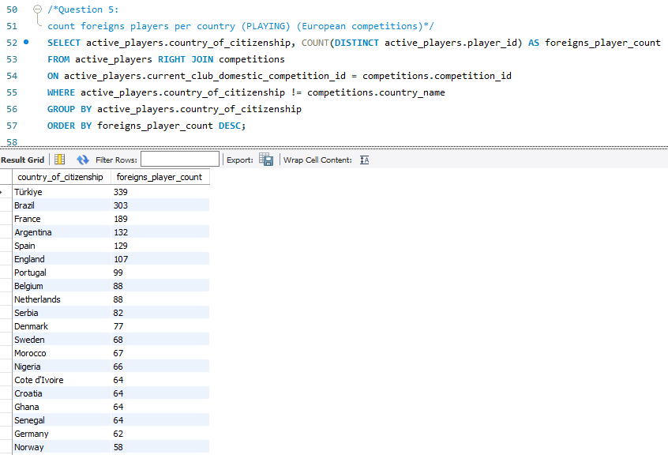
Question 5:
Num foreigners players per country (PLAYING) (European competitions)

Slide 10
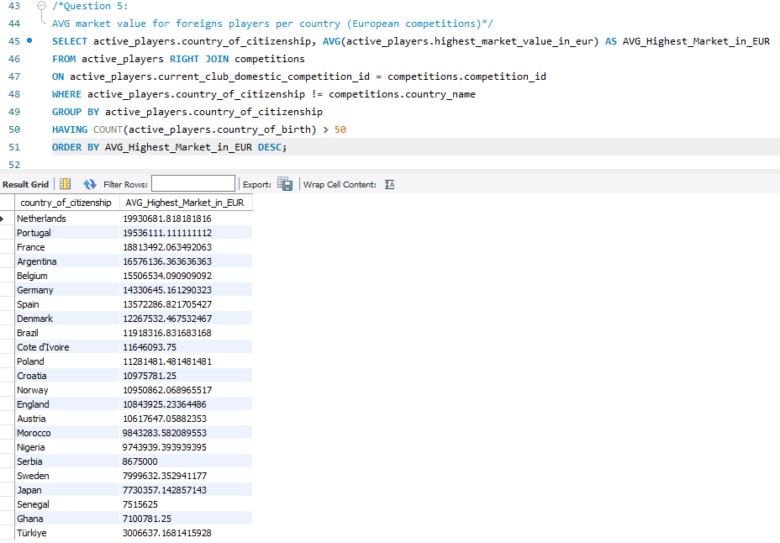
Question 6:
AVG market value for foreigners players per country (European competitions) (MAX)

Slide 11
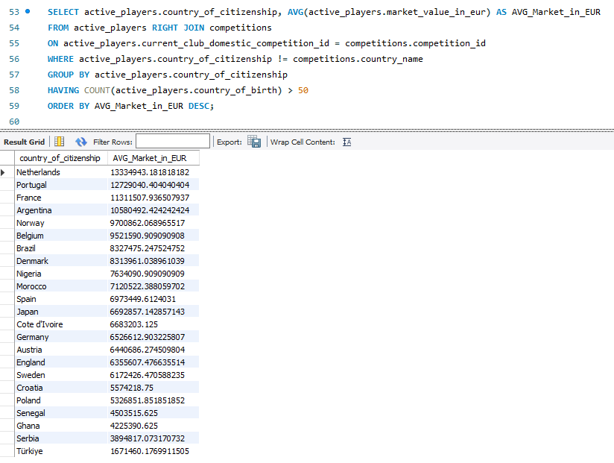
Question 7:
AVG market value for foreigners players per country (European competitions) (AVG)

Slide 12
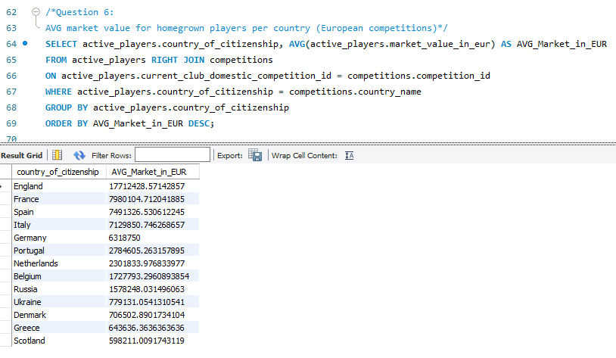
Question 8:
AVG market value for homegrown players per country (European competitions)

Slide 13
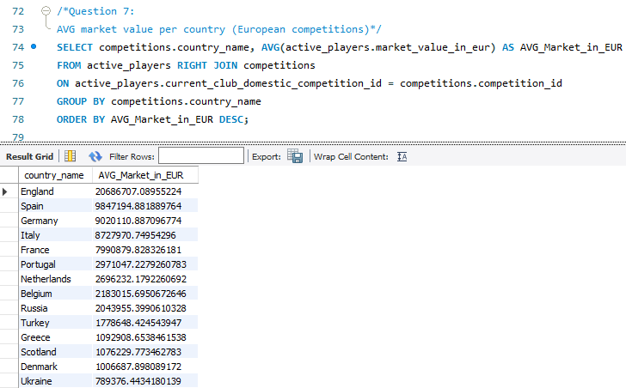
Question 9:
AVG market value per country (European competitions)

Slide 14
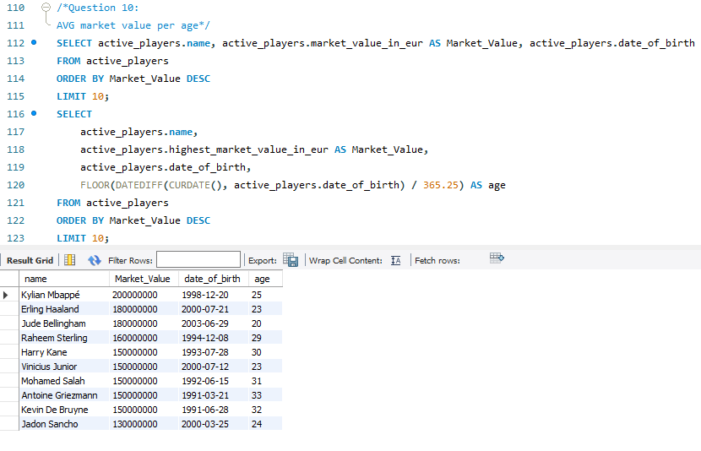
Question 10:
AVG market value per age

Slide 15
Questions?

